Slide 1
BIOSPHERE CHALLENGE 2019
Our Best Environmental Action

Slide 2
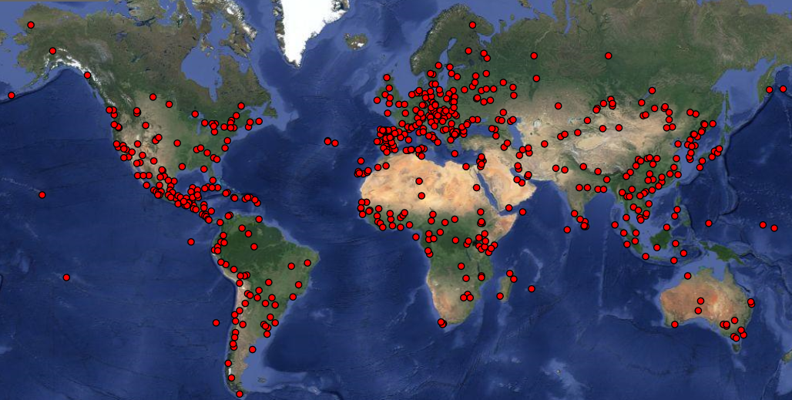
We live in a UNESCO Biosphere Reserve
WHO CHOSE US? A Biosphere Reserve is designated by UNESCO, United Nation’s Education, Science and Cultural Organisation.
WHAT IS A BIOSPHERE RESERVE? A Biosphere Reserve is a region where people thrive in harmony with nature, creating better conditions for future generations to live on our Planet Earth.

Slide 3
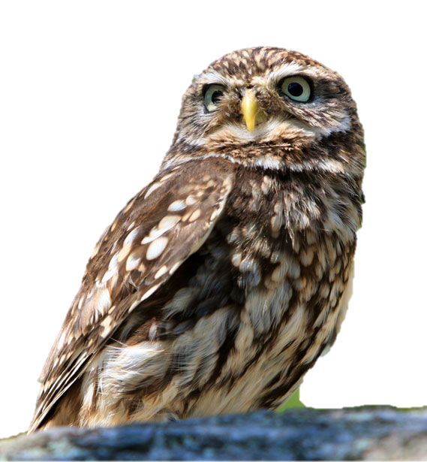
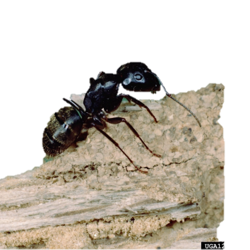
We live in a UNESCO Biosphere Reserve
We, who live in the Biosphere Reserve, should act collectively to adapt our ways of living to make a stronger contribution to a sustainable future. There are more than 600 Biosphere Reserves in the world.
It is easy to live sustainably… or?

Slide 4
Living sustainably
EVERYONE who lives on our planet use resources, like food, water, wood, fuel, and metals. These are all things we need to survive and to have a good life. Today, these resources are unevenly distributed.
WE ALL must consider that our CHILDREN and GRANDCHILDREN need food, clean water and good soil to survive.

Slide 5
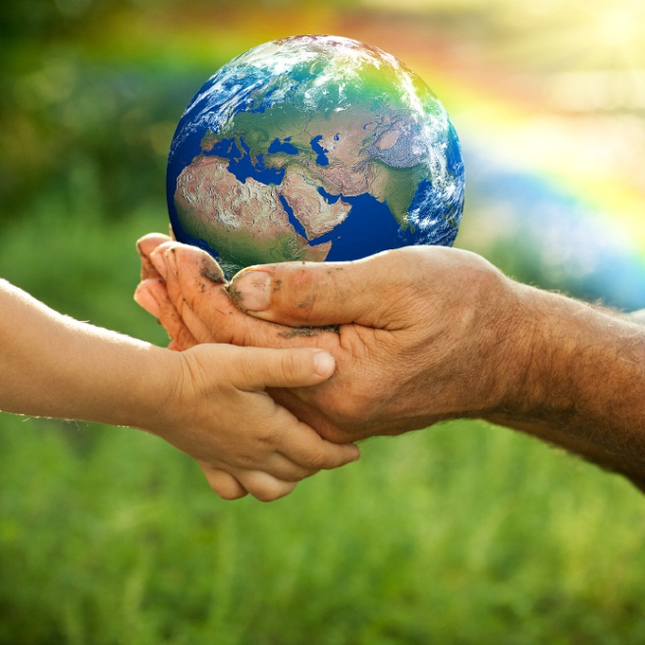
BIOSPHERE CHALLENGE 2019
Our Best Environmental Action

Slide 6
Does it matter what Action you select?
Think about this for a minute and discuss your thoughts in class.

Slide 7
DID YOU COME TO ANY CONCLUSIONS?

Slide 8
WHEN MANY PEOPLE DO SOMETHING SMALL, IT GIVES GREAT EFFECTS!
It makes a difference when the entire class is involved in an Environmental Action…
… and you can reach even greater
effects if you inspire someone else!
Here are some ideas:

Slide 9
IF YOU RIDE YOUR BICYCLE…
If 15 pupils in your class ride their bicycle to school instead of traveling by car:
1,5 kilometers,
4 days per week,
You will ”save” 7 liters of petrol each week.

Slide 10
IF YOU MAKE YOUR SCHOOL MORE ENERGY EFFICIENT…
If every school changed their light bulbs to LED light bulbs, they will save money due to reduced energy costs.
In Sweden, that saving would be big
enough to employ 1000 new teachers!

Slide 11
IF YOU TRADE CLOTHES WITH EACH OTHER…
Re-using saves energy, water and chemicals.
Let us pretend your class has 30 pupils.
If everyone in your class changed one T-shirt with a class mate instead of bying a new T-shirt, you would save 80 000 liters of water and 12 kg of chemicals!
And everyone would be glad to have a ”new shirt”.

Slide 12
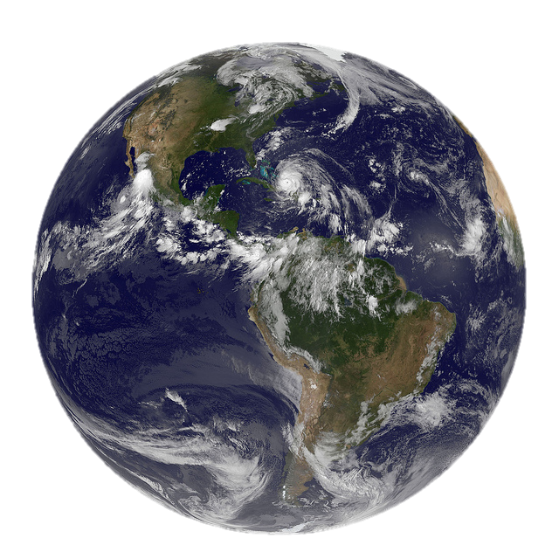
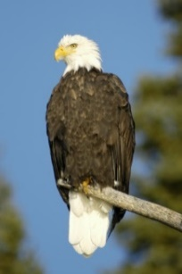
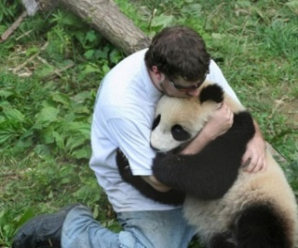
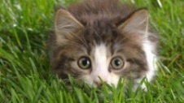
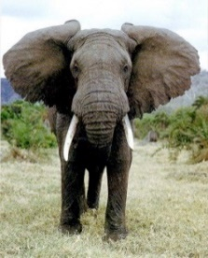
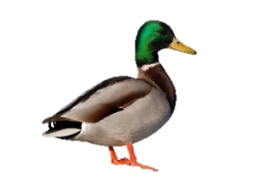
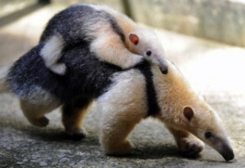
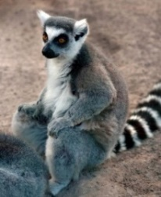
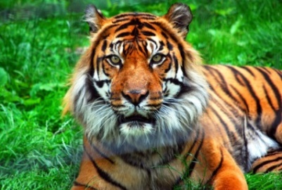
Your first task is to decide which Environmental Action would have the most positive impact on the environment.
Can you make the Action even more fun?
Plan and carry out the activity.
Report on why you selected this activity and why it was the most important activity for you?

Slide 13
IT IS CALLED DEMOCRACY
The class decides which Environmental Action they should do. It is important that everyone takes part in making the decision.
When you vote, all votes have the same value!

Slide 14
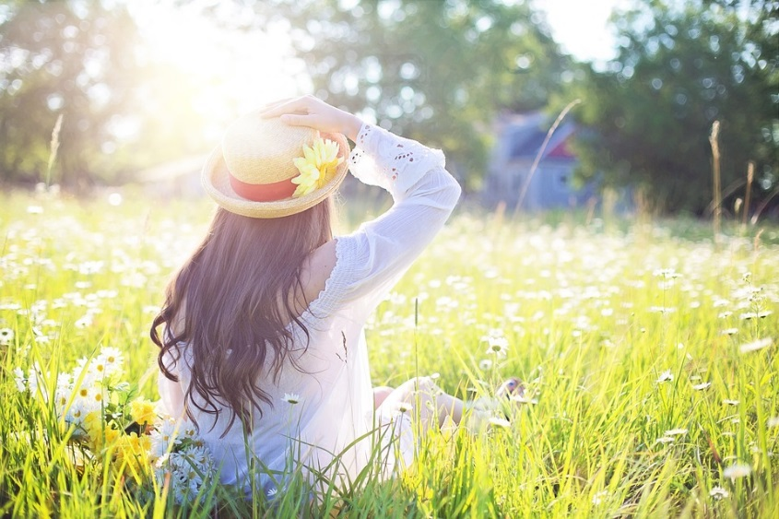
YOU ARE NOT ALONE!
SCHOOL CLASSES IN OTHER BIOSPHERE RESERVES ARE DOING THE SAME THING!
Together, we are collecting many great Environmental Actions. When the Biosphere Challenge is completed, you can see what school classes in other parts of the world has done. Perhaps you will find inspiration to do something new. After the Challenge is complete, you can find them here: www.vanerkulle.org/Biosfarutmaningen-2019

Slide 15
THE CHALLENGE
If you want, you can be part of a competition!
A jury, composed by Biosphere Ambassadors active in Biosphere Reserve Lake Vänern Archipelago, will select a HONORARY WINNER!

Slide 16
RULES – THE JURY VOTES
The jury will consider:
Your motivation of the positive environmental impact
Your creativity in how to make the Action even more fun
How you carried out the Action
If you inspired others and if you will continue your Environmental Action after the Challenge is completed.

Slide 17
P.S REMEMBER THAT EVERYONE CAN PARTICIPATE
Collectively, we gather many great ideas of things that are good for the environment and fun too!
Your ideas may inspire others to take action as well!

